Slide 1

American International University- Bangladesh EEE 2104 : Electronic Devices Lab Presentation
PROJECT TITLE
H-BRIDGE MOTOR DRIVER
COURSE TEACHER : S M TANVIR HASAN SHOVON
SECTION : BB
GROUP : 06

Slide 2
AGENDA
01. OBJECTIVE
02. TYPES
03. WORKING METHOD
04.RESULT & DISCUSSION
05.FUTURE SCOPE

Slide 3
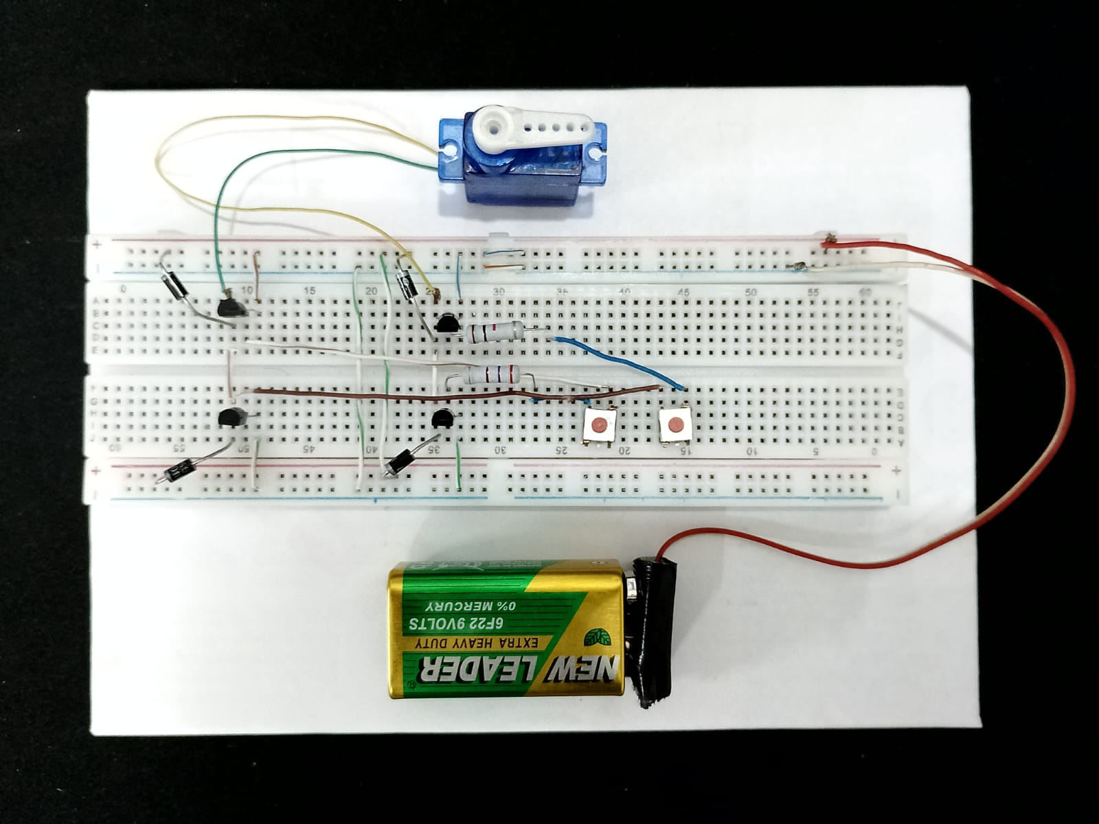
OBJECTIVE
Bidirectional Motor Control
Speed Regulation
Efficient Power Management
Safe and Reliable Operation
Integration with Control Systems
Support for Various Motor Loads
Compact and Scalable Design
Cost-Effective Implementation
User Control and Customization

Slide 4
TYPES OF H BRIDGE MOTOR DRIVER
Transistor-Based H-Bridge
Integrated Circuit (IC)-Based H-Bridge
Half-Controlled H-Bridge
Fully Controlled H-Bridge
Single H-Bridge
High-Power/ Low-Power H-Bridge

Slide 5
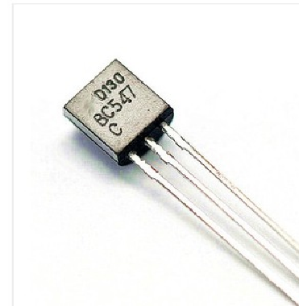
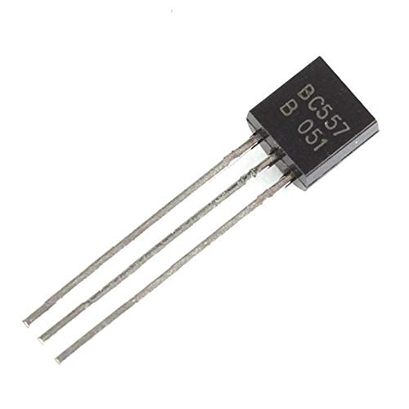
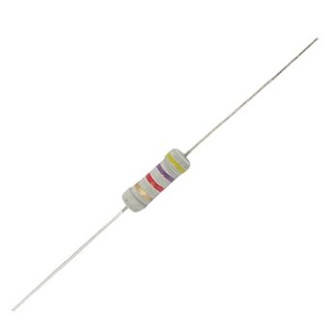
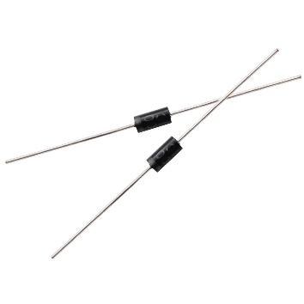

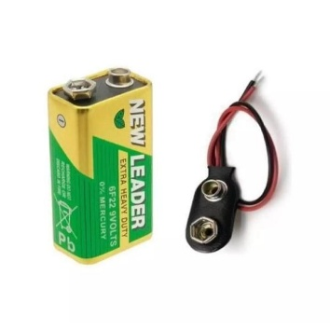
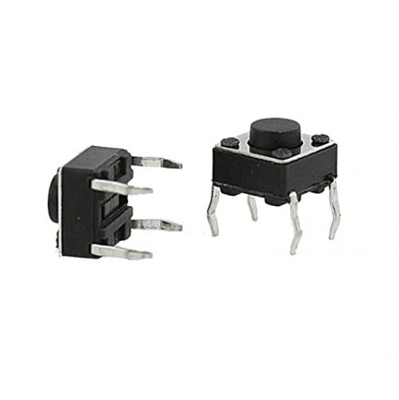
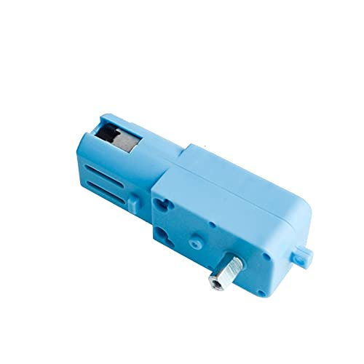

Components
NPN Transistor
(BC547)
PNP Transistor
(BC557)
1k ohm resistor
Diode
9V Battery
Push Button Switch
Jumper wire
Gear Motor
Breadboard

Slide 6
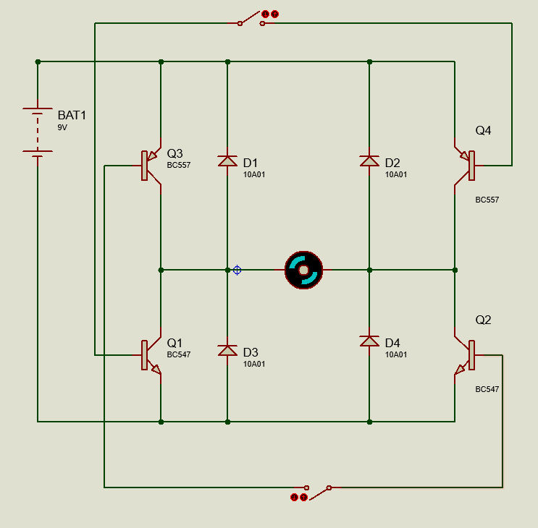
Working Method
Structure: Four switches (Q1, Q2, Q3, Q4) form an "H" configuration.
Forward Motion: Close S1 ; current flows in one direction through the motor.
Reverse Motion: Close S2; current flows in the opposite direction through the motor.
Braking: Close or open both switches at the same time (S1 & S2).
Safety: Avoid activating switches on the same time (S1 & S2) to prevent short circuits.

Slide 7
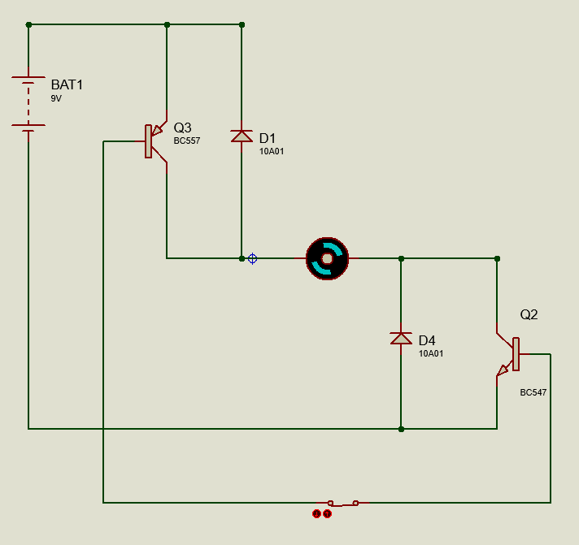
Working Method
Structure: Four switches (Q1, Q2, Q3, Q4) form an "H" configuration.
Forward Motion: Close S1 ; current flows in one direction through the motor.
Reverse Motion: Close S2; current flows in the opposite direction through the motor.
Braking: Close or open both switches at the same time (S1 & S2).
Safety: Avoid activating switches on the same time (S1 & S2) to prevent short circuits.

Slide 8
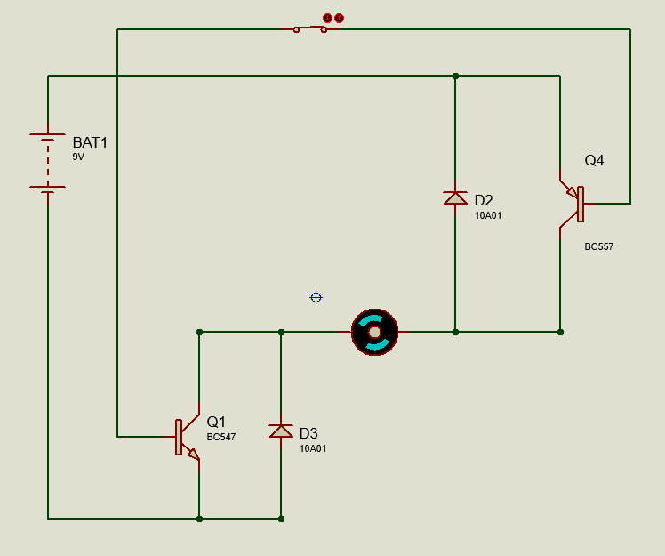
Working Method
Structure: Four switches (Q1, Q2, Q3, Q4) form an "H" configuration.
Forward Motion: Close S1 ; current flows in one direction through the motor.
Reverse Motion: Close S2; current flows in the opposite direction through the motor.
Braking: Close or open both switches at the same time (S1 & S2).
Safety: Avoid activating switches on the same time (S1 & S2) to prevent short circuits.

Slide 9
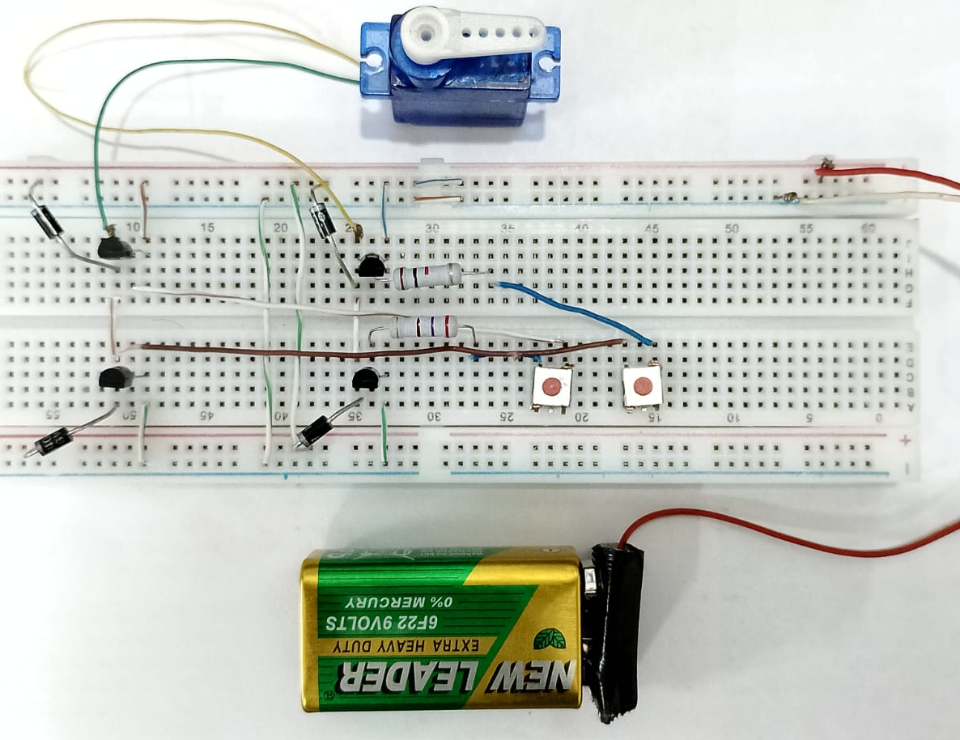
Control Techniques
Bidirectional Control
Switching Logic
Protection Mechanisms
Feedback Control

Slide 10
Results
Motor Control Validation
Thermal Performance
Protection Effectiveness
Efficiency

Slide 11
Discussion
Performance Analysis
Advantages
Challenges
Future Improvements
Real-World Applications

Slide 12
Challenges & Limitations
Heat Loss
Voltage Spikes
High power loss in the form of heat due to switching elements
Switching transients can cause damaging voltage spikes
Cross-Conduction Issues
occurs when both high-side and low-side switches are on simultaneously, causing a short circuit
Limited Control Accuracy
Motor speed and direction control can be limited by the Pulse Width Modulation (PWM) resolution

Slide 13
Wireless and Remote Control Capabilities It may feature built-in wireless technologies such as Wi-Fi, Bluetooth, or Zigbee.
Future Scopes
Development of Autonomous Vehicles
It will be essential for controlling various motors such as steering, braking, and propulsion systems.
IoT and Smart Systems
Applications like home automation, industrial systems, and smart agriculture will expand their use.
Renewable Energy Systems It will enhance the efficiency of solar panels by controlling motors of the solar tracking system, wind turbine motor

Slide 14
Conclusion​
The H-Bridge Motor Driver is a versatile and essential component for motor control applications.
Its ability to enable bidirectional operation, speed control, and protection mechanisms ensures stability and reliability.
Simulations and experiments demonstrated effective performance under varying conditions.
While challenges like power losses and noise exist, future enhancements can address these issues for even better efficiency.

Slide 15
Thank you

Slide 16
Q & A
?

